Slide 1
Case Study I1: Talent and Income
Neil Benson

Slide 2
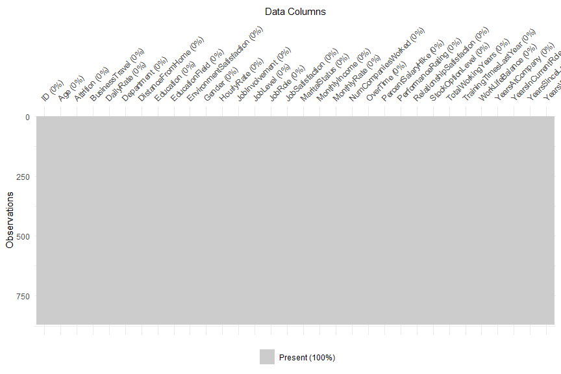
Cleaning the Data
Filled missing values by applying average IBU and ABV per style of beer for greater accuracy.

Slide 3
Profile of Attrition
Profile of Attrition:
Median Age: 32
Department: Research & Development
Education Field: Life Sciences
Gender: Men
Job Role: Sales Executive
Marital Status: Single
Median Years at Company: 3
Median Total Working Years: 6.5
Median Monthly Income: $3,171
Median Distance from Home: 9

Slide 4
Job Role Specific Trends
Job Role | Avg Job Satisfaction | Avg Monthly Income | Avg Total Working Yrs | Avg Yrs At Company | Avg Yrs In Current Role | Avg Yrs Since Last Promotion | Avg Yrs w/ Curr Manager
Healthcare Representative | 2.83 | $7,435 | 14 | 9 | 5 | 3 | 5
Human Resources | 2.56 | $3,285 | 6 | 5 | 3 | 1 | 3
Laboratory Technician | 2.69 | $3,222 | 8 | 5 | 3 | 1 | 3
Manager | 2.51 | $17,197 | 25 | 14 | 6 | 4 | 6
Manufacturing Director | 2.72 | $7,505 | 12 | 8 | 5 | 2 | 5
Research Director | 2.49 | $15,750 | 21 | 10 | 6 | 3 | 6
Research Scientist | 2.80 | $3,259 | 8 | 5 | 3 | 2 | 3
Sales Executive | 2.73 | $6,892 | 11 | 8 | 5 | 3 | 5
Sales Representative | 2.70 | $2,653 | 4 | 3 | 2 | 1 | 2

Slide 5
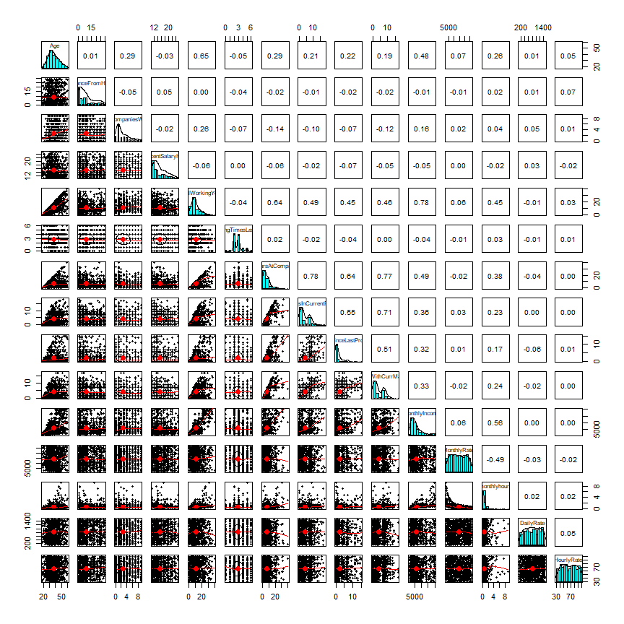
Cleaning the Data
Almost half (~42%) of IBU data was missing, and a little over 2.5% of ABV data was missing.

Slide 6
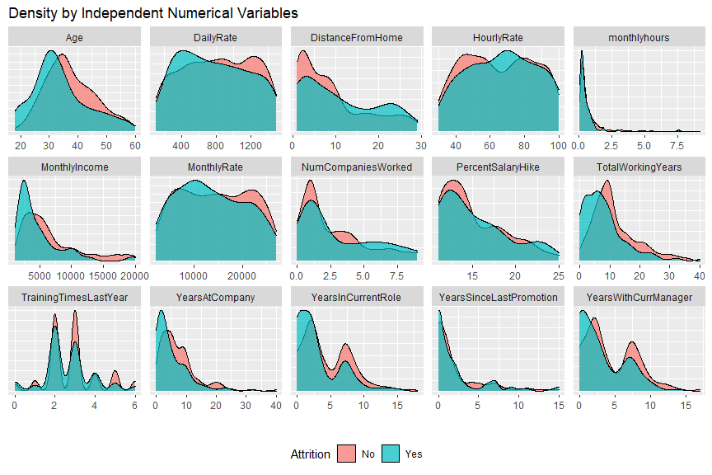
Median ABV and IBU per State
Most beers fell within relative range for median ABV of each other with only a handful of states significantly differing from the rest.

Slide 7
most influential predictor factors for attrition
• OverTime
– pvalue: < 8.45e-13
• JobInvolvement
– pvalue: < 2.92e-06
• JobLevel
– pvalue: 0.00108

Slide 8
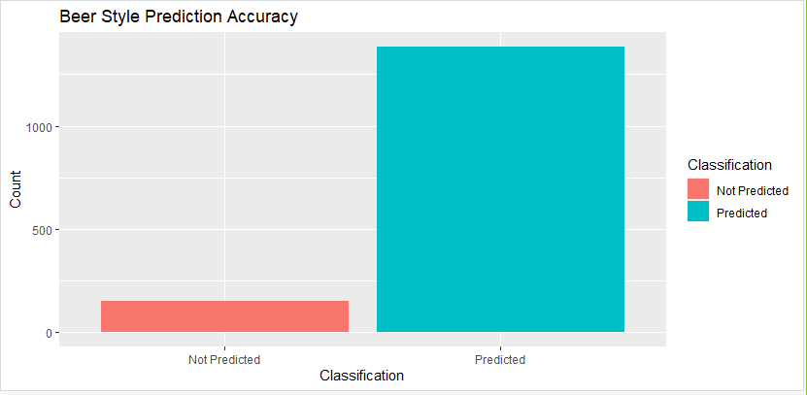
Prediction Accuracy – NAÏVE BAYES
When given an IBUs and ABV only, we can reliably categorize between IPAs and Ales with 90.22% accuracy (with 95% confidence interval between 88.62% and 91.66%). This shows that there is a very strong, statistically significant relationship between IBUs and ABV% for identifying IPAs and Ales.

Slide 9
MODEL OPTIMIZATION
Attrition Model:
Attrition ~ JobInvolvement + JobSatisfaction + MaritalStatus + NumCompaniesWorked + OverTime + StockOptionLevel + YearsSinceLastPromotion + JobLevel + TotalWorkingYears + YearsWithCurrManager
Accuracy Sensitivity Specificity
0.7857143 0.7826087 0.7894737
Income Model:
MonthlyIncome ~ Age + BusinessTravel + JobLevel + Education + TotalWorkingYears
Multiple R-squared Adjusted R-squared RMSE
0.9278 0.9246 1187.83

Slide 10
LINKS
Repository – https://github.com/bensonnd/msds/tree/master/ds6306/CaseStudy2DDS
Neil YouTube Video - https://youtu.be/s5X5uf_ModA
Prediction Data Located at:
https://github.com/bensonnd/msds/tree/master/ds6306/CaseStudy2DDS/data
Case2PredictionsBenson Attrition.csv
Case2PredictionsBenson Salary.csv
Code Located at:
https://github.com/bensonnd/msds/tree/master/ds6306/CaseStudy2DDS/code
Knit/HTML Located at:
https://github.com/bensonnd/msds/tree/master/ds6306/CaseStudy2DDS/html

